Slide 1
Servlets (Weightage- 14 , Hrs-10)

Slide 2
Servlets
Servlet technology is used to create a web application (resides at server side and generates a dynamic web page).
Servlet technology is robust and scalable because of java language.
Before Servlet, CGI (Common Gateway Interface) scripting language was common as a server-side programming language,there were many disadvantages to this technology.
There are many interfaces and classes in the Servlet API such as Servlet, GenericServlet, HttpServlet, ServletRequest, ServletResponse, etc.

Slide 3
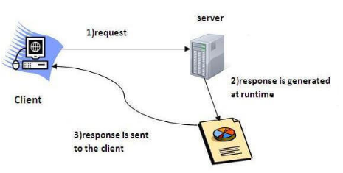
What is a Servlet?
Servlet is a technology which is used to create a web application.
Servlet is an API that provides many interfaces and classes including documentation.
Servlet is an interface that must be implemented for creating any Servlet.
Servlet is a class that extends the capabilities of the servers and responds to the incoming requests. It can respond to any requests.
Servlet is a web component that is deployed on the server to create a dynamic web page.

Slide 4
What is a web application?
A web application is an application accessible from the web.
A web application is composed of web components like Servlet, JSP, Filter, etc. and other elements such as HTML, CSS, and JavaScript.
The web components typically execute in Web Server and respond to the HTTP request.

Slide 5
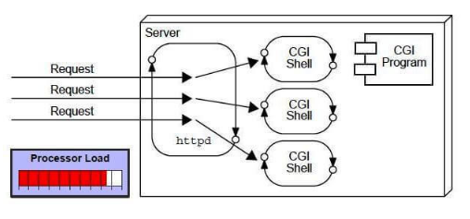
CGI (Common Gateway Interface)
CGI technology enables the web server to call an external program and pass HTTP request information to the external program to process the request. For each request, it starts a new process.

Slide 6
Disadvantages of CGI
There are many problems in CGI technology:
If the number of clients increases, it takes more time for sending the response.
For each request, it starts a process, and the web server is limited to start processes.
It uses platform dependent language e.g. C, C++, perl.

Slide 7
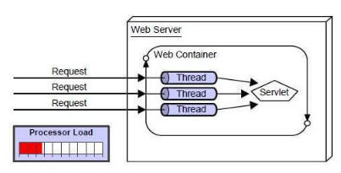
Advantages of Servlet
There are many advantages of Servlet over CGI. The web container creates threads for handling the multiple requests to the Servlet.
Threads have many benefits over the Processes such as they share a common memory area, lightweight, cost of communication between the threads are low.
The advantages of Servlet are as follows:
Better performance: because it creates a thread for each request, not process.
Portability: because it uses Java language.
Robust: JVM manages Servlets, so we don't need to worry about the
memory leak, garbage collection, etc.
Secure: because it uses java language.

Slide 8
Servlet API
The javax.servlet and javax.servlet.http packages represent interfaces and classes for servlet api.
The javax.servlet package contains many interfaces and classes that are used by the servlet or web container. These are not specific to any protocol.
The javax.servlet.http package contains interfaces and classes that are responsible for http requests only.

Slide 9
Interfaces of javax.servlet package.
Servlet
ServletRequest
ServletResponse
RequestDispatcher
ServletConfig
ServletContext
SingleThreadModel
Filter
FilterConfig
FilterChain
ServletRequestListener
ServletRequestAttributeListener
ServletContextListener
ServletContextAttributeListener

Slide 10
Classes in javax.servlet package
There are many classes in javax.servlet package. They are as follows:
GenericServlet
ServletInputStream
ServletOutputStream
ServletRequestWrapper
ServletResponseWrapper
ServletRequestEvent
ServletContextEvent
ServletRequestAttributeEvent
ServletContextAttributeEvent
ServletException
UnavailableException

Slide 11
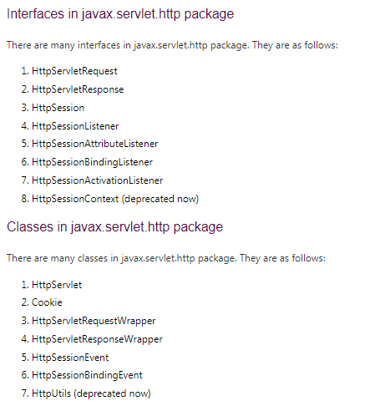

Slide 12
Servlet Interface
Servlet interface provides common behavior to all the servlets.
Servlet interface defines methods that all servlets must implement.
Servlet interface needs to be implemented for creating any servlet (either directly or indirectly).
It provides 3 life cycle methods that are used to initialize the servlet, to service the requests, and to destroy the servlet

Slide 13
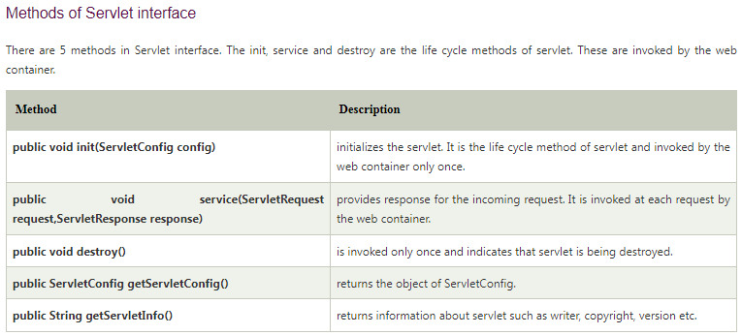

Slide 14
ServletConfig Interface
An object of ServletConfig is created by the web container for each servlet. This object can be used to get configuration information from web.xml file.
If the configuration information is modified from the web.xml file, we don't need to change the servlet. So it is easier to manage the web application if any specific content is modified from time to time.
Advantage of ServletConfig
The core advantage of ServletConfig is that you don't need to edit the servlet file if information is modified from the web.xml file

Slide 15
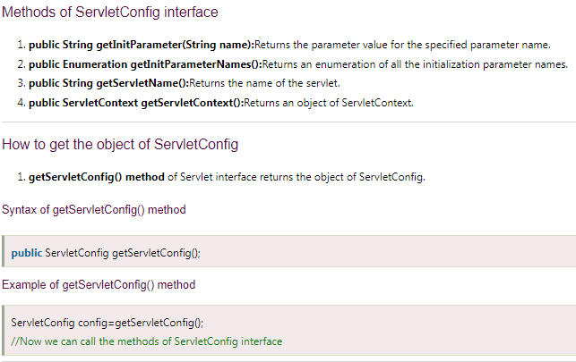

Slide 16
ServletContext Interface
An object of ServletContext is created by the web container at time of deploying the project. This object can be used to get configuration information from web.xml file. There is only one ServletContext object per web application.
If any information is shared to many servlet, it is better to provide it from the web.xml file using the <context-param> element.
Advantage of ServletContext
Easy to maintain if any information is shared to all the servlet, it is better to make it available for all the servlet. We provide this information from the web.xml file, so if the information is changed, we don't need to modify the servlet. Thus it removes maintenance problem.

Slide 17
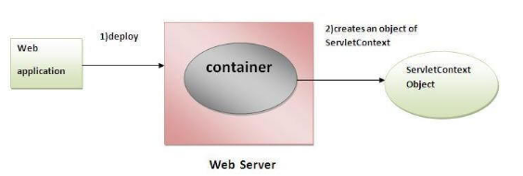
Usage of ServletContext Interface
The object of ServletContext provides an interface between the container and servlet.
The ServletContext object can be used to get configuration information from the web.xml file.
The ServletContext object can be used to set, get or remove attribute from the web.xml file.
The ServletContext object can be used to provide inter-application communication.

Slide 18
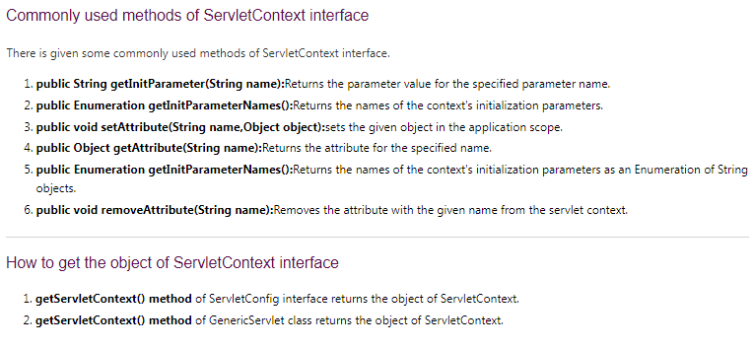

Slide 19
ServletRequest Interface
An object of ServletRequest is used to provide the client request information to a servlet such as content type, content length, parameter names and values, header informations, attributes etc.

Slide 20
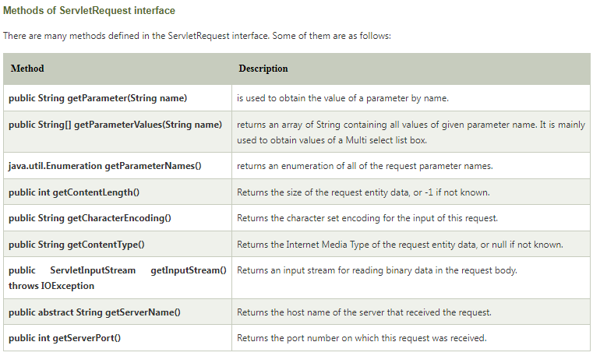

Slide 21
ServletResponse Interface
A servlet can use this object to help it provide a response to the client.
A ServletResponse object is created by the servlet container and passed as an argument to the servlet’s service function.

Slide 22
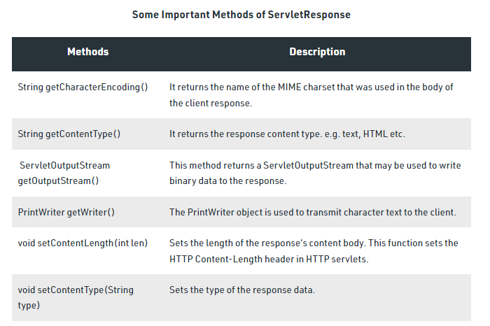

Slide 23
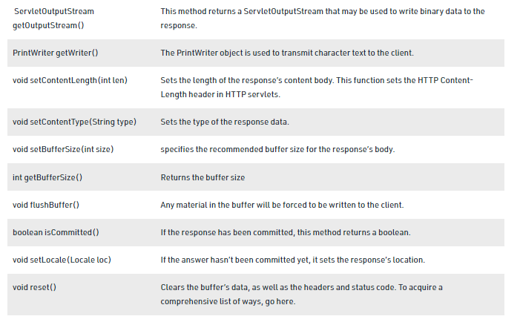

Slide 24
GenericServlet class
It implements Servlet, ServletConfig and Serializable interfaces.
It provides the implementation of all the methods of these interfaces except the service method.
GenericServlet class can handle any type of request so it is protocol-independent.
You may create a generic servlet by inheriting the GenericServlet class and providing the implementation of the service method.

Slide 25
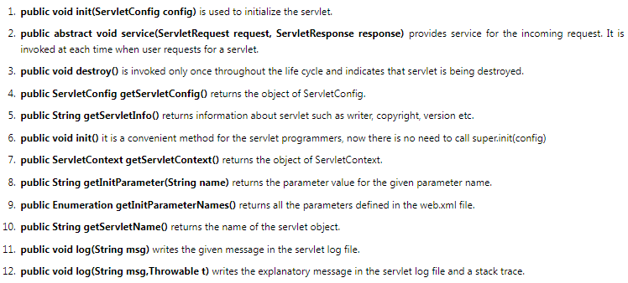
Methods of GenericServlet class

Slide 26
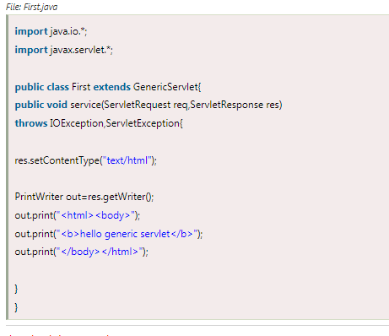

Slide 27
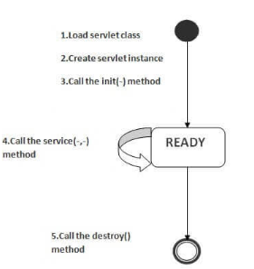
Life Cycle of a Servlet (Servlet Life Cycle)
The web container maintains the life cycle of a servlet instance. Let's see the life cycle of the servlet:
Servlet class is loaded.
Servlet instance is created.
init method is invoked.
service method is invoked.
destroy method is invoked.

Slide 28
1) Servlet class is loaded
The classloader is responsible to load the servlet class. The servlet class is loaded when the first request for the servlet is received by the web container.
2) Servlet instance is created
The web container creates the instance of a servlet after loading the servlet class. The servlet instance is created only once in the servlet life cycle.
3) init method is invoked
The web container calls the init method only once after creating the servlet instance. The init method is used to initialize the servlet. It is the life cycle method of the javax.servlet.Servlet interface. Syntax of the init method is given below:
public void init(ServletConfig config) throws ServletException
4) service method is invoked
The web container calls the service method each time when request for the servlet is received. If servlet is not initialized, it follows the first three steps as described above then calls the service method. If servlet is initialized, it calls the service method. Notice that servlet is initialized only once. The syntax of the service method of the Servlet interface is given below:
public void service(ServletRequest request, ServletResponse response)
5) destroy method is invoked
5) destroy method is invoked
The web container calls the destroy method before removing the servlet instance from the service. It gives the servlet an opportunity to clean up any resource for example memory, thread etc. The syntax of the destroy method of the Servlet interface is given below:
public void destroy()

Slide 29
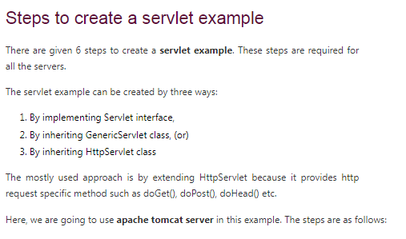
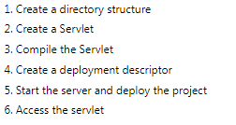

Slide 30
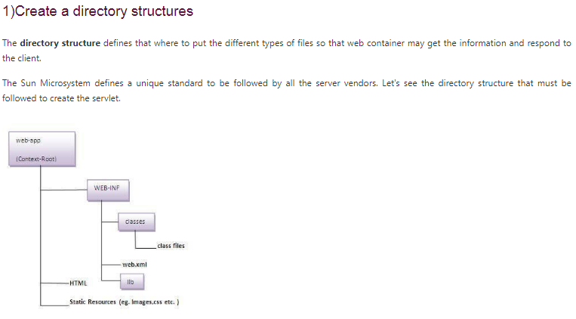
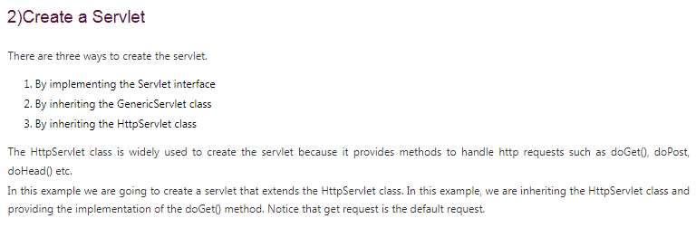

Slide 31
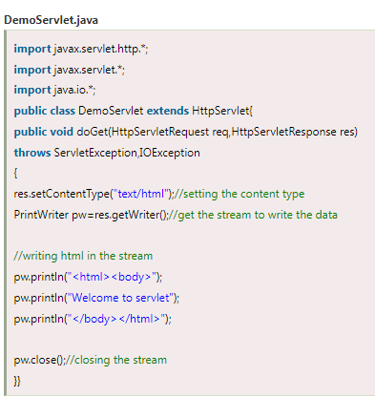

Slide 32
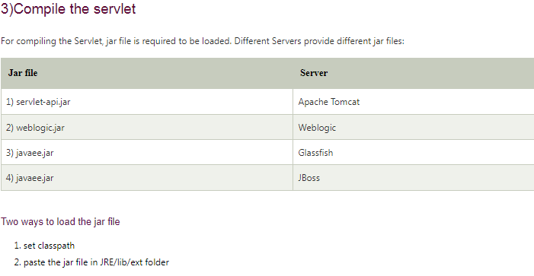
4)Create the deployment descriptor (web.xml file)
The deployment descriptor is an xml file, from which Web Container gets the information about the servet to be invoked.
The web container uses the Parser to get the information from the web.xml file. There are many xml parsers such as SAX, DOM and Pull.
There are many elements in the web.xml file. Here is given some necessary elements to run the simple servlet program.

Slide 33
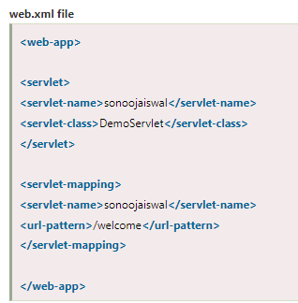
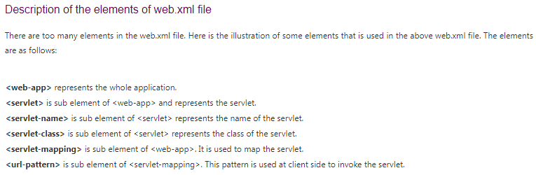

Slide 34
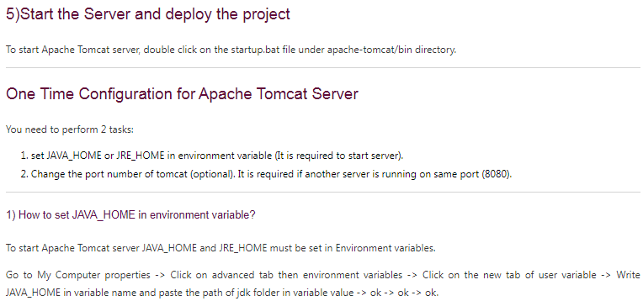

Slide 35
HttpSessionEvent and HttpSessionListener
The HttpSessionEvent is notified when session object is changed.
The corresponding Listener interface for this event is HttpSessionListener.

Slide 36
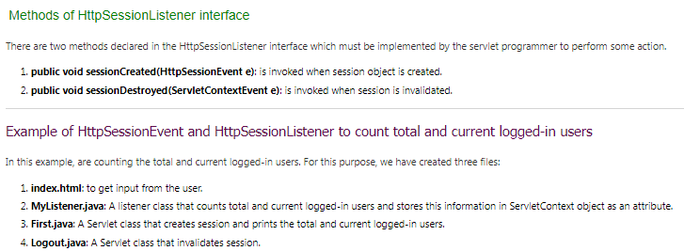

Slide 37
Servlet Interface
Servlet interface provides commonbehaviorto all the servlets.Servlet interface defines methods that all servlets must implement.
Servlet interface needs to be implemented for creating any servlet (either directly or indirectly). It provides 3 life cycle methods that are used to initialize the servlet, to service the requests, and to destroy the servlet and 2 non-life cycle methods.

Slide 38
How Servlet works?
It is important to learn how servlet works for understanding the servlet well. Here, we are going to get the internal detail about the first servlet program.
The server checks if the servlet is requested for the first time.
If yes, web container does the following tasks:
loads the servlet class.
instantiates the servlet class.
calls the init method passing the ServletConfig object
calls the service method passing request and response objects

Slide 39
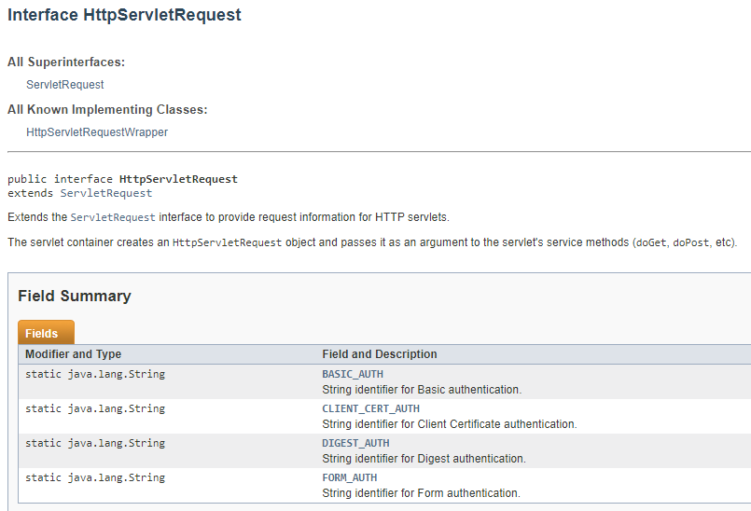

Slide 40
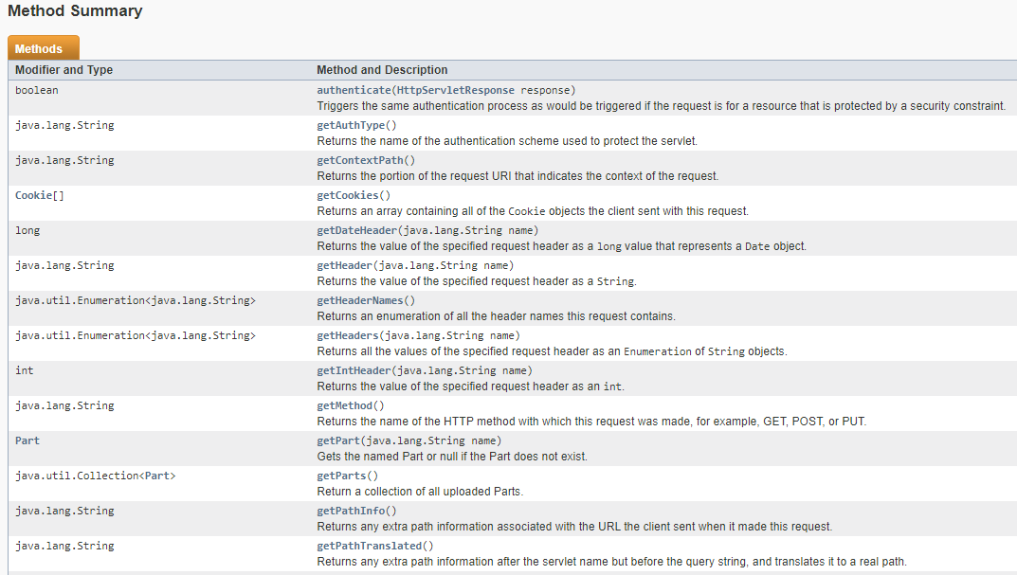

Slide 41
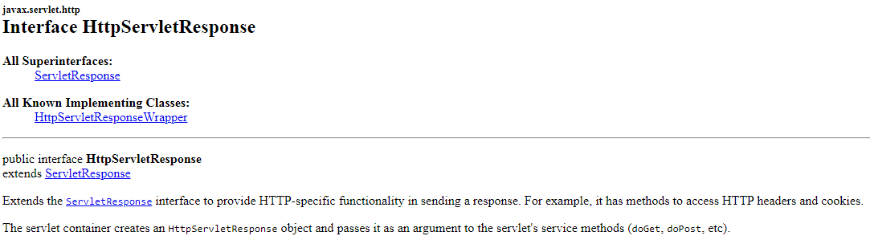

Slide 42
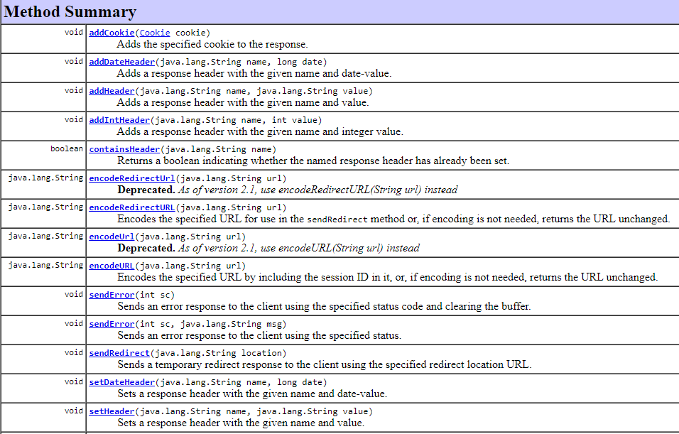

Slide 43
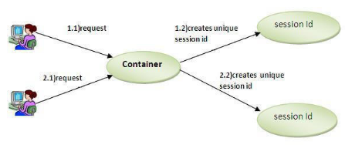
HttpSession interface
In such case, container creates a session id for each user.
The container uses this id to identify the particular user.
An object of HttpSession can be used to perform two tasks:
bind objects
view and manipulate information about a session, such as the session identifier, creation time, and last accessed time.

Slide 44
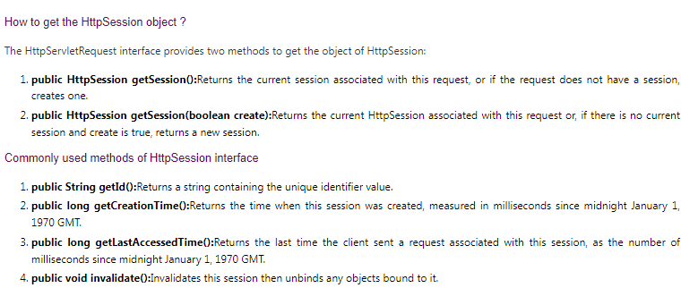

Slide 45
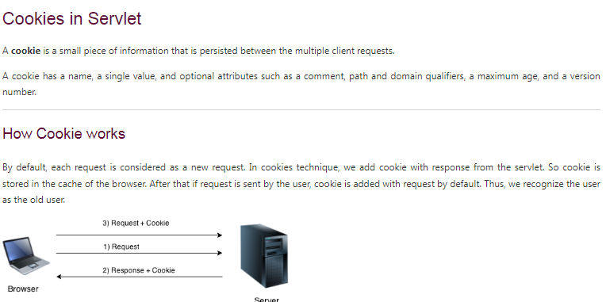

Slide 46
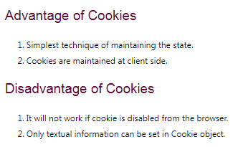
Types of Cookie
There are 2 types of cookies in servlets.
Non-persistent cookie
Persistent cookie
Non-persistent cookie
It is valid for single session only. It is removed each time when user closes the browser.
Persistent cookie
It is valid for multiple session . It is not removed each time when user closes the browser. It is removed only if user logout or signout.

Slide 47
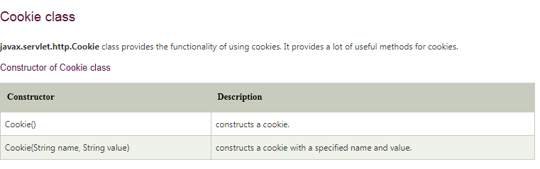
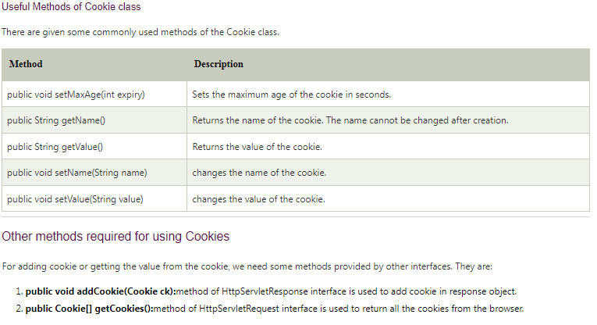

Slide 48
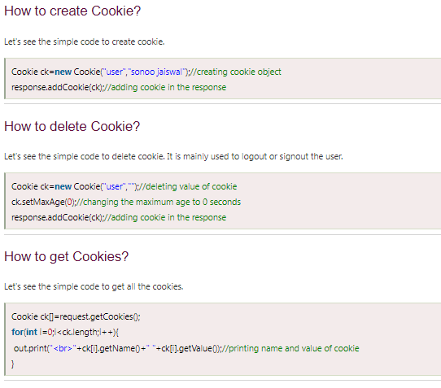

Slide 49
HttpServlet class
The HttpServlet class extends the GenericServlet class and implements Serializable interface.
It provides http specific methods such as doGet, doPost, doHead, doTrace etc.

Slide 50
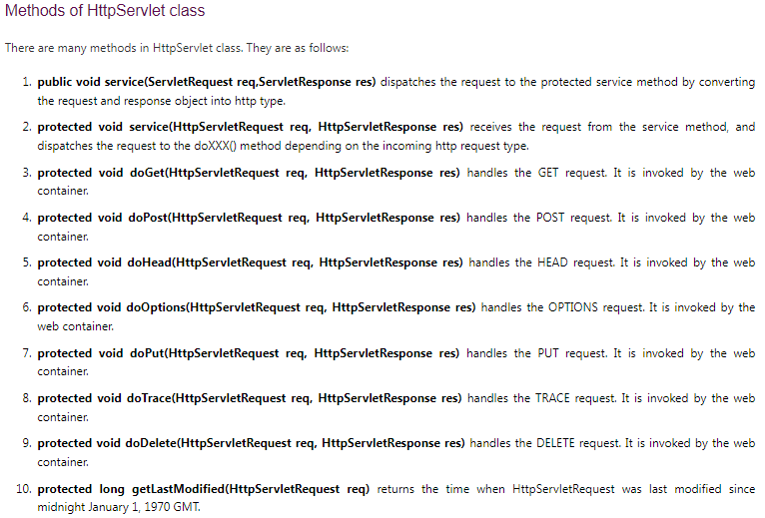

Slide 51
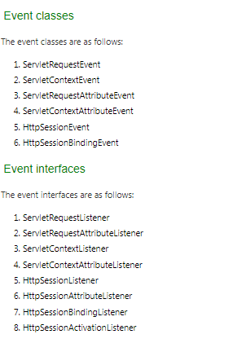
Event and Listener in Servlet
Events are basically occurance of something. Changing the state of an object is known as an event.

Slide 52
Applets | Servlets
A Java applet is a small application which is written in Java and delivered to users in the form of bytecode. | A servlet is a Java programming language class used to extend the capabilities of a server.
Applets are executed on client side. | Servlets are executed on server side.
Applets are used to provide interactive features to web applications that cannot be provided by HTML alone like capture mouse input etc. | Servlets are the Java counterpart to other dynamic Web content technologies such as PHP and ASP.NET.
Life cycle of Applets init(), stop(), paint(), start(), destroy(). | Lifecycle of servlets are:- init( ), service( ), and destroy( ).
Packages available in Applets are :- import java.applet.*; and import java.awt.*. | Packages available in servlets are:- import javax.servlet.*; and import java.servlet.http.*;
Applets use user interface classes like AWT and Swing. | No User interface required.
Applets are more prone to risk as it is on the client machine. | Servlets are under the server security.
Applets utilize more network bandwidth as it executes on the client machine. | Servlets are executed on the servers and hence require less bandwidth.
Requires java compatible browser for execution. | It accepts input from browser and generates response in the form of HTML Page, Javascript Object, Applets etc.

